Slide 1

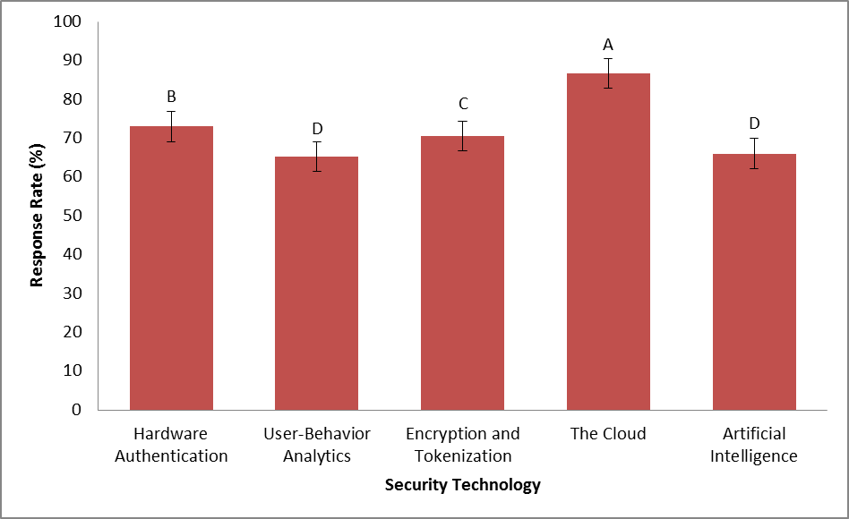
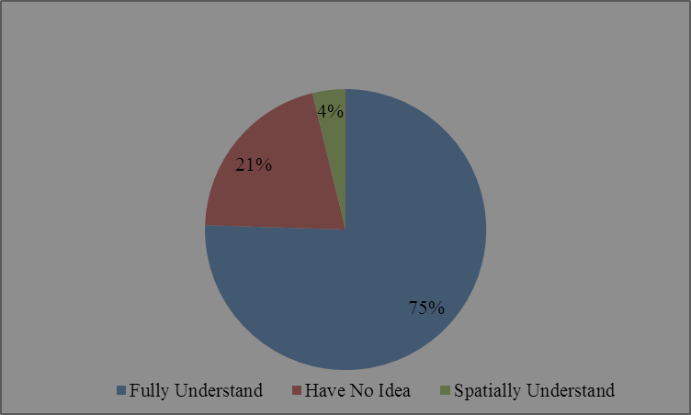
Compliance to laws and Security of Websites
People who did the study
University/Institution
INTRODUCTION
The internet is an invaluable source of information thus accessed by many individuals. It is highly recommended and for this reason need for security. Security is a major concern and the government is working tirelessly to ensure measures are in place (Yand et al.2008).The privacy debate has coevolved with the development of Information technology. Increase in technology in terms means increase in cybercrimes like Phishing and Pharming. . Advances in technology and the diminishing website privacy are at the forefront as the driving force between website privacy and human ethics. Data breaches due to phishing attacks on websites of weak privacy policies have impact on both the website owner and the user. Thus laws were put in place to counter the menace. The General Data Protection Regulation is a decree applying to every state that are in EU notwithstanding and gives guidelines to actions on data. It was introduced abruptly thus many establishments were not ready to welcome it. The study was targeted to groping the law compliances on websites by soliciting information on compliance of websites and their security.
Questions of Research
The key objective of the research was to comprehend compliance of current websites to the laws on privacy of data and user’s awareness on the same. Purposive approach was applied in the research questions.
Which measures and legal constraints have been put in place for shield to counter unauthorised access of data?
What are the hazards tangled with non-written URLs usage?
Are the users well acquitted with the compliance of websites and security?
METHODOLOGY
Qualitative approach was applied for the research. Interviews, Observations and issuance of questionnaires were the main gadgets of collecting data. Triangulation of the results will ensure clarity of the information collected. Social psychoanalytical theories were applied together with phenomelogy and interactionism. Inductive ontological will be applied in the study to determine the design and link noncompliance and human actions. Since it’s a study involving humans, interpretive thinking is applied since humans have mixed opinions.
Data methods
Questionnaires
Each questionnaire carried 10 questions that were closed and open ended. They were used to solicit user’s knowledge of website compliance. Responses were analysed through the epistemology model
Interviews
Closed questions together with open questions were applied. The method was appropriate it gave way to the investigator to look for clarity to unclear responses. The questions were driven to the subject of security and compliance of websites. Phenomenology theory was used. Inductive analysis was employed in the study.
Observation
Direct judgement of the observer through collection of primary data increases the authenticity of the information collected on the interviews and questionnaires. The researcher made use of verbal and non-verbal ques as the respondents answered. Inductive analysis was applied on the deductions got.
Sampling
A total of volunteer individuals were used. Purposive sampling was applied from managers of websites to their end users. Forms of consent were issued to the participants. Collection of data occurred in distraction free zones away from noise.
FINDINGS OF THE RESEARCH
Web security and law compliance
Questions were yes or no and 80% of the participants were mindful of the complacency of websites to laws while 15% were in the dark concerning the compliances. Most of them were for the vote that organizations need to be in compliance with regulations from government regulatory firms. One responded said, “Indeed, websites in Europe are greatly controlled by the finest of technology practises that protect the users and business”. Less than 5% of the respondents had spatial knowledge and were unable to give detailed explanations due to lack of facts. The participants were also asked of regulations they know in place that would enhance web safety and it included tokenization, computer user behaviour analytics, encryption and hardware authentication. Hardware authentication included 70% of the population and encryption and tokenization taking 70.5% preference.
Hazards tangled with non-written URL’s
Varied opinions were got concerning the question.18% of the participants had not even a clue as to the nature of non-written URLs were. From the remaining, 10% did not see the risk of theses websites as they are sometimes inevitable. However, majority voiced their complaints they sometimes redirect the user to unknown sites without their consent and this makes them unsafe when sharing personal information. . A unique response was got from one of the respondents who said that “I’m not sure of the risk related to usage of non-written URLs.
User knowledge on compliance of websites and security
Out of the 50, half the number was aware that the government and other organizations have impacted laws on website compliance to protect users’ information. However, the other half did not know the regulations in place. One respondent said, “I’m unaware of the tactics for security of websites”. Two thirds of the participants were unable to provide concrete strategies for overcoming challenges of compliance to the law while the other third were able to mention them comfortably.
Discussion
Thematic analysis was applied in this study for comparison of strengths and weaknesses of website compliance. Deductions were built on the triangulation of the answers got from thematic analysis of data. End users were used as case studies. Web security is a matter of concern to both the public and organizations with equal effects to both parties. The findings prove that operators and the companies should be in the light concerning the benefits of complying with web security laws. Europe is a well-known pioneer to the drive for security compliance and that’s why many users were able to identify the various strategies put in place to ensure compliance to the compliance of websites. The study showed that non written URLs impact a great hazard to the users as they are subject to phishing attacks and sending malware and viruses. Screening properties should be employed to filter these URLs.
CONCLUSION
Based on the findings of the various legal appliances and the various technological securities against unauthorized access of data .GDPR was ranked as the number one taking favour to most respondents. It was then followed up with the Privacy and Electronic Communications Regulations (PECR) then the Data Protection Act (DPA) where information on website security is located. Based on income approach,18% of the participants weren’t aware of the hazards of non-written URL’s.Most argued that these sites are dangerous and should be avoided at all times .However, the remaining 5% were comfortable with the sites saying that they are sometimes inevitable.
Recommendations
In this study, qualitative approach was employed in obtaining data .In future research papers, recommendations are being made to rather use quantitative approach to rather get additional information that was rather not available in the research approach used in the current study to rather enhance the richness of data. It was also found out that the breakthrough in the law compliance is a factor of collaborations among users and service providers. Sensitization should be done to all individual from very background to ensure compliance .This can be achieved through training, organisations that highlight the needs and profits of agreement.
Bibliography
Cranor, L. Internet privacy: A public concern. networker 2, 3 (June/July 1998), 13–18.
Oppliger, R. Internet security: firewalls and beyond. Commun. ACM 40, 5 (May 1997), 92–102.
Rubin, A. and Greer, D. A survey of World Wide Web security. IEEE Computer 31, 9 (Sept. 1998), 34–41

